Slide 1
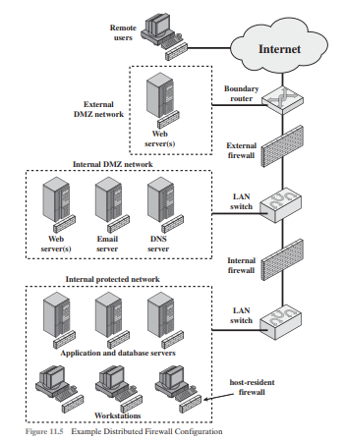
A firewall is a security gateway, the Demilitarized Zone (DMZ) is protected from both the outside world and the rest of the cooperate LAN by firewalls.
Firewall functionality can be implemented as a software module in a router or LAN switch
Local configurations include a secure LAN known as a DMZ identified at 1.2.4.0/24.

Slide 2
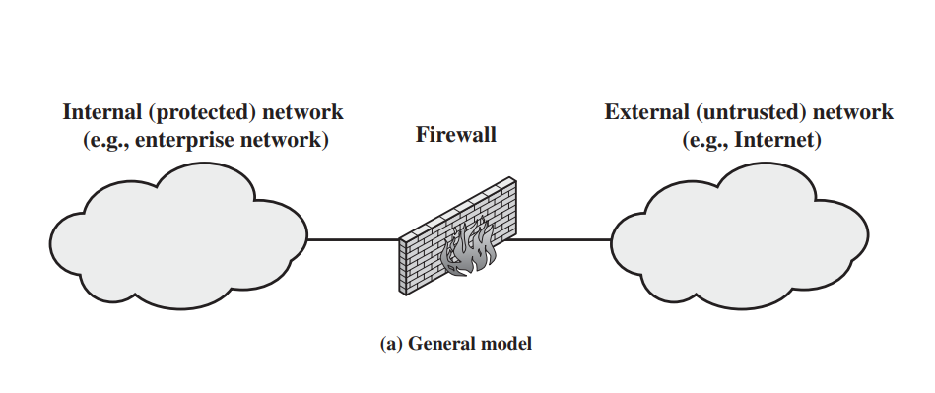

Slide 3
Types of Firewalls
A Packet Filtering Firewall
A firewall can operate as a positive filter allowing to pass only packets that meet a specific criteria or a negative filter rejecting a packet that meets a certain criteria.
The firewall is configured to filter packets going from and to the internal network.
The packet filter is based on the list of rules based on matches in the IP and TCP header if there is a match the rule is invoked to determine whether to forward or discard the packet.

Slide 4
Filtering rules are based on information contained in a network packet.
Source IP address
Destination IP address
Source and destination transport-level address
IP protocol field – defines the Transport protocol
Interface for a firewall of three or more ports.

Slide 5
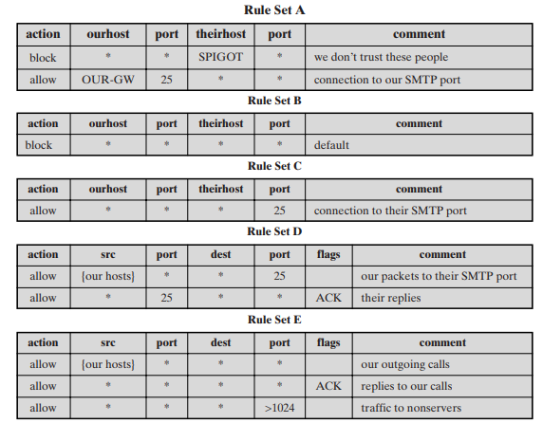
Packet Filtering Examples

Slide 6
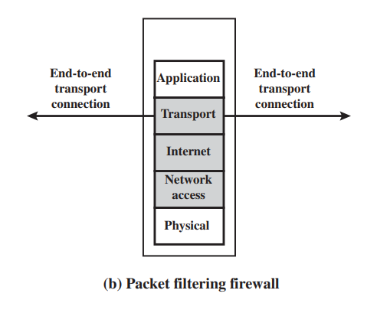

Slide 7
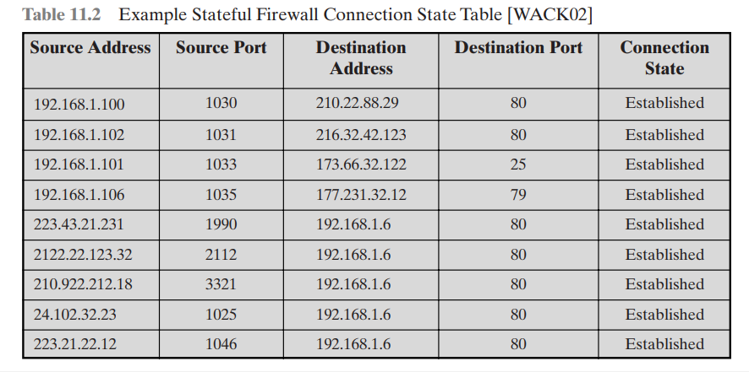
Stateful Inspection firewalls

Slide 8
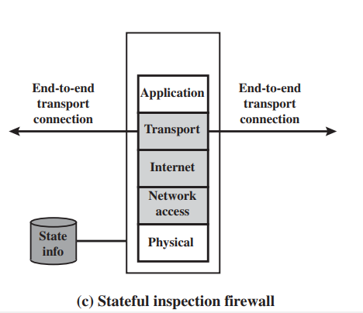
Stateful inspection firewall A stateful inspection packet firewall tightens up the rules for TCP traffic by creating a directory of outbound TCP conncetions

Slide 9
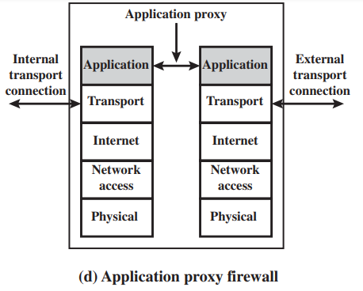
Application level gateway
Application level gateway known as an application proxy.

Slide 10
An application proxy acts as a relay of application level traffic where a user contacts the gateway using a TCP/IP application such as telnet or FTP.

Slide 11
Circuit level gateway
It can be a stand-alone system or a specialized function performed by an application level gateway for certain applications.
a circuit-level gateway does not permit an end-to-end TCP connection but the gateway sets up two TCP connections, one between itself and a TCP user on an inner host and one between itself and a TCP user on an outside host.
An example of a circuit-level gateway implementation is the SOCKS package.
SOCKS component include the SOCKS server which often runs on a UNIX-based firewall.
SOCKS is also implemented on Windows systems.
The SOCKS client library which runs on internal hosts protected by the firewall.

Slide 12
